Slide 1


A Californian dream…
Understanding the limitations of the housing market in the United States
By Reena Agrawal, Adam Nguyen, Jose Dominguez
July 2019

Slide 2


November 2019… you just became a Data Analyst! Congratulations!
Shall we start looking for jobs as Data Analyst?
Check your inbox! You got 5 offers from 5 cities in California!
Tech company in San Jose, CA
Surf company in Santa Cruz, CA
Fintech company in San Francisco, CA
Winery in Napa, CA
Aerospace company Los Angeles, CA

Slide 3

Where would your salary take you?
Your average salary is $100K, not bad eh?
But remember…
“The general recommendation is to spend about 30% of your gross monthly income on rent.”
Your housing budget is$2,500/month

Slide 4
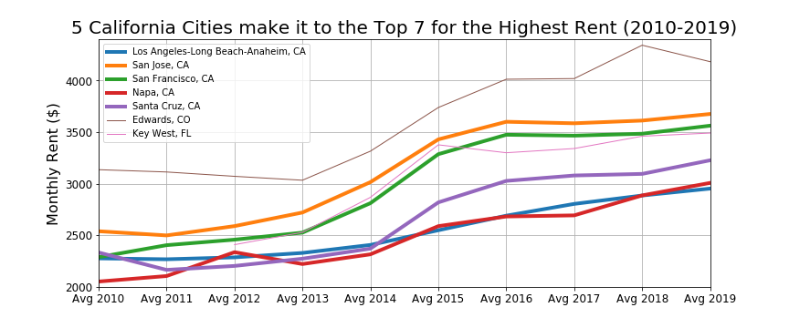
Affordability vs Average Rental Price
Your are here!
Sorry to say… but you cannot afford renting in any of these cities…
But don’t feel bad, let’s look for a place you can afford.
Highest Monthly Rents in USA

Slide 5
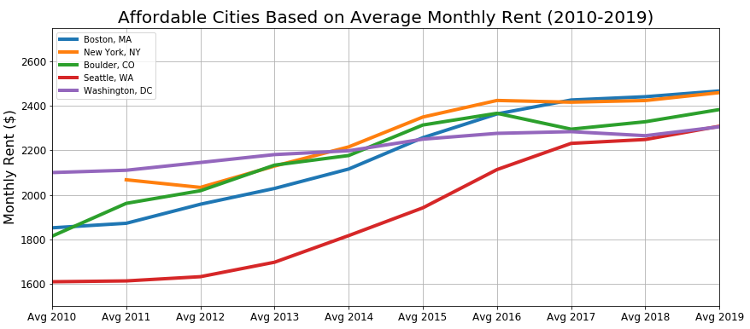
So… where can you go instead?
Top Cities you could afford
Boston, MA
New York, NY
Boulder, CO
Seattle, WA
Washington, DC
Affordable Top Cities to Rent

Slide 6
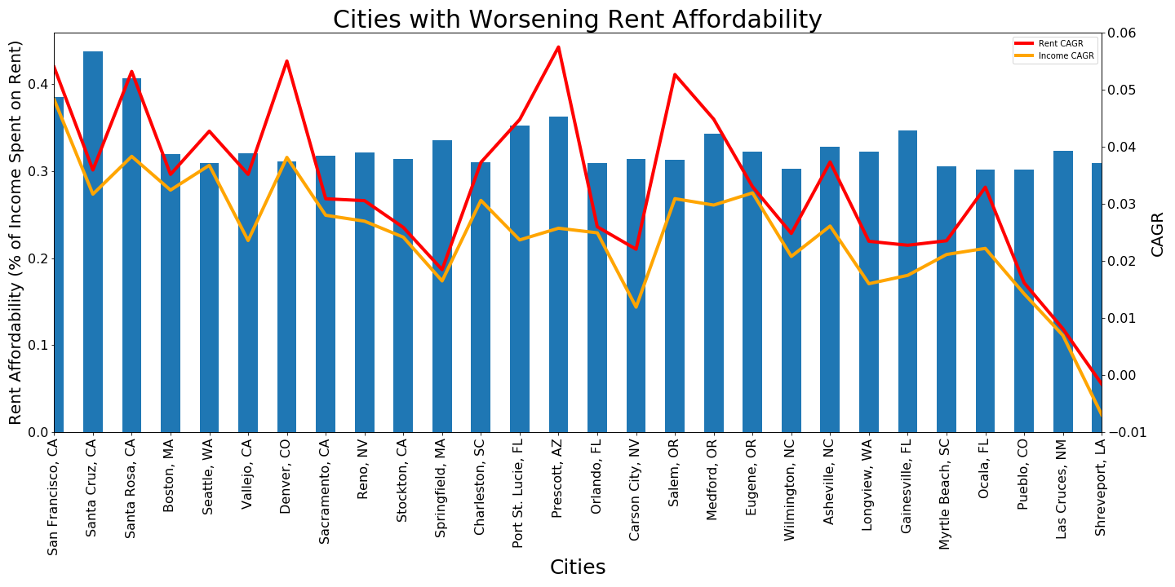
Cities with Worsening Rent Affordability Ratio
Avoid them too if you can!
Cities with worsening rent affordability

Slide 7
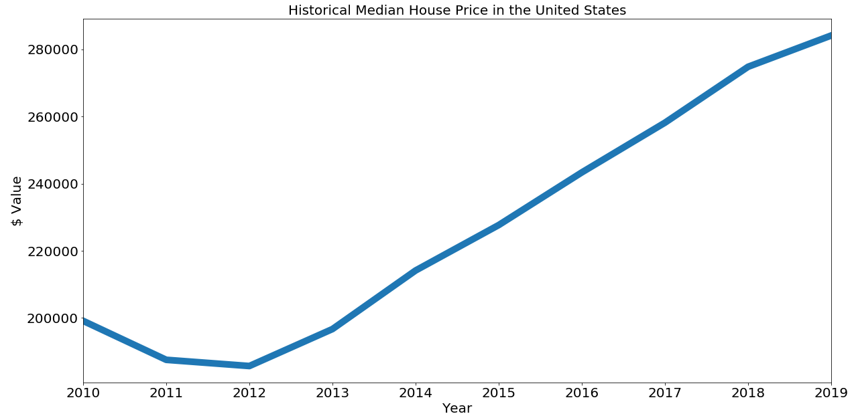
Why renting? Let’s buy a house!
Don’t get depressed and check your inbox again!
2010 -2018 Median Selling Price in USA

Slide 8
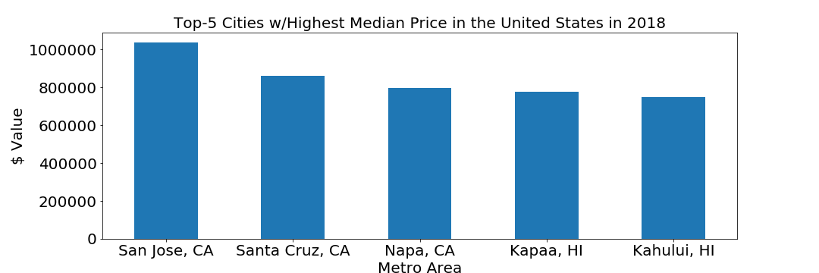
Finding a place to buy a house
Awesome! 5 new offers! And your spouse is getting some too! You guys are moving out of your parent’s basement!
Top Cities w/Highest Median Price in 2018
You only want to make sure that those jobs are not here…

Slide 9
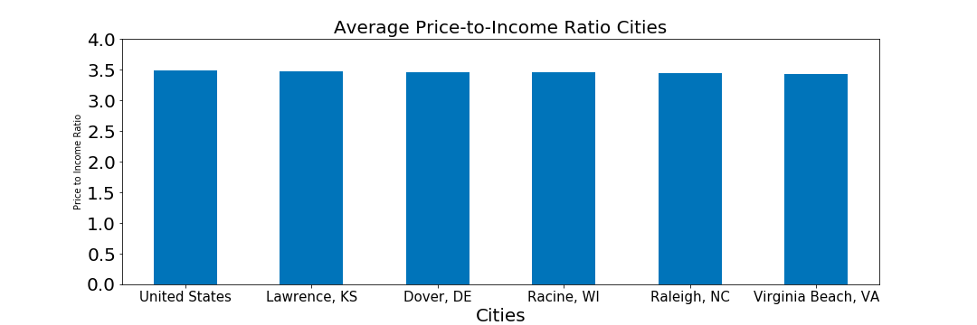
Affordable? What’s that?
Oh did you tell everybody you and your spouse were making $200k combined? Nice!
Price-to-Income Ratio

Slide 10
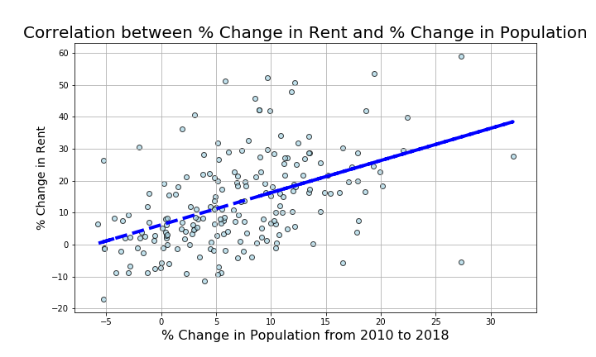
Any other Options?
Wait, what about looking less crowded city?
That could work...or you might want to go back to college to get your bachelor’s degree
Correlation between % Change in Rent & % Change in Population

Slide 11
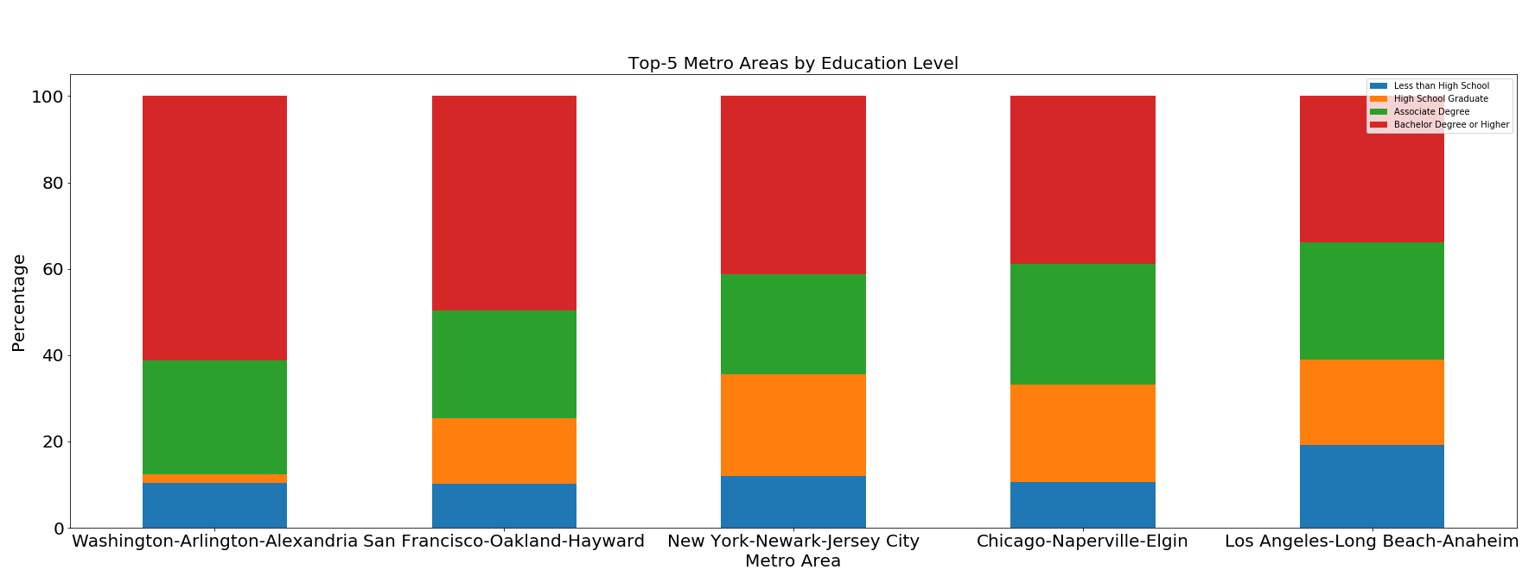
Top Cities with Highest % of population with at least Bachelor’s Degree
Hey check Chicago, Washington or NY metro areas!
Lucky you they didn’t hit our top 5 most expensive cities and they’re still awesome!
Top Cities with highest population with Bachelor or higher degree

Slide 12

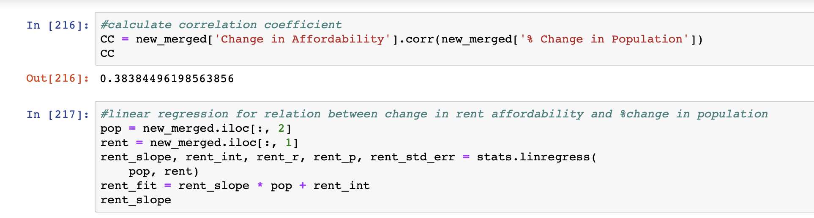
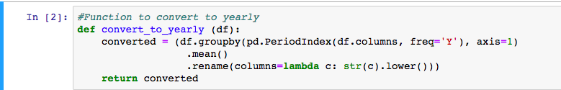

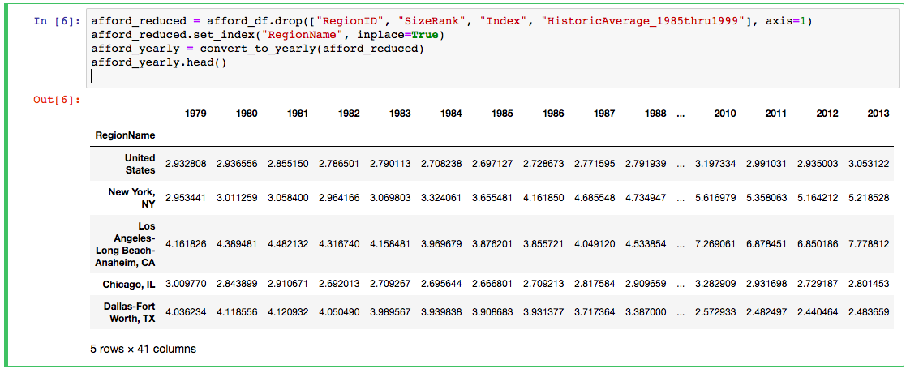
How did we get these results?
Data powered by Zillow.com & the US Census Bureau

Slide 13

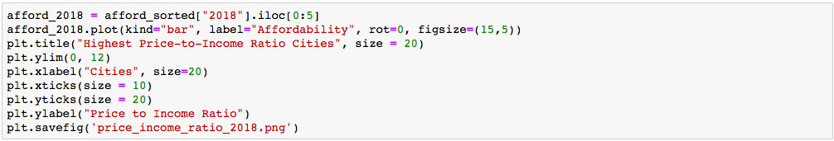
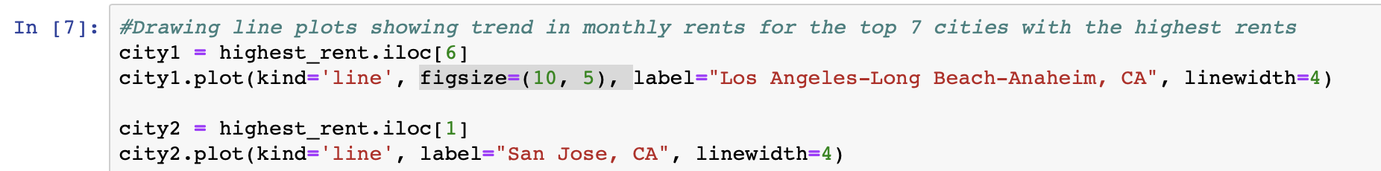
More code for the kids…

Slide 14

Thanks for your time!

